Slide 1
The Black Death and the Hundred Years War

Slide 2
How did it happen?
The plague
Epidemic – rapid-spreading disease
Bubonic plague – carried by fleas on rats
Came from ship carrying grain headed for Sicily
Arrived in 1347 – by 1351 almost all of Europe had the plague
Rats were everywhere!

Slide 3
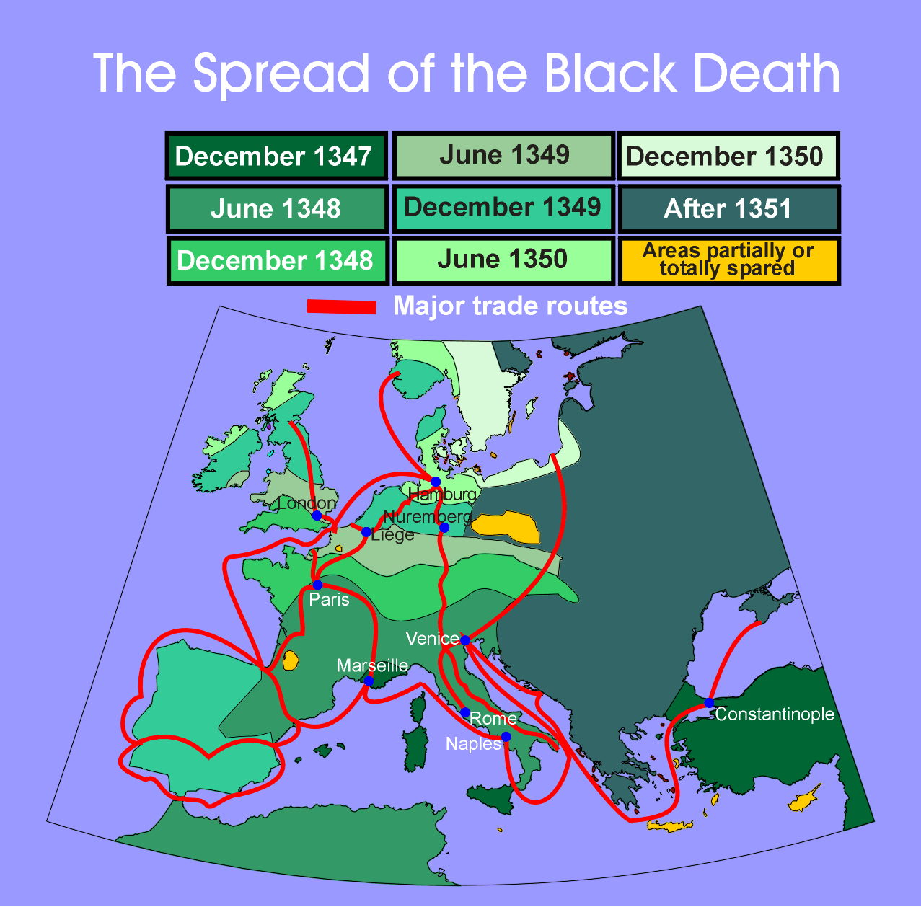

Slide 4
One Rat may be cute

Slide 5
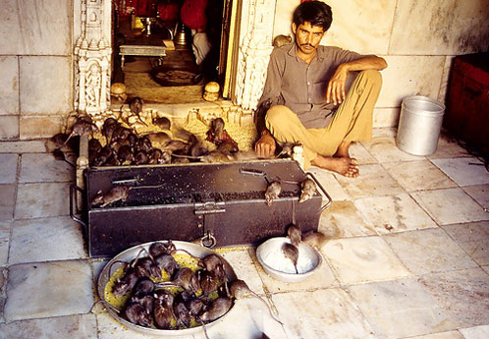
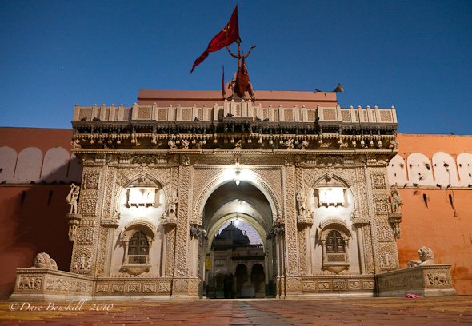
Many rats are vermin that carry disease

Slide 6
Rat Temple in India

Slide 9
Impact of the Plague
Reaction
Terror, fear, confusion, bewilderment – how do we stop it?
Magic, witchcraft
Pied Piper?
Gave into pleasures – going to die, so…
Sinners – whipped themselves
Fled cities
Blamed – yep – that’s right

Slide 10
Economy
Long term
Inflation – kept high wages with less production
Peasants sent into towns – lost farm jobs
Could they find jobs? No – why?
Cropland turned into pastures
Revolts broke out

Slide 11
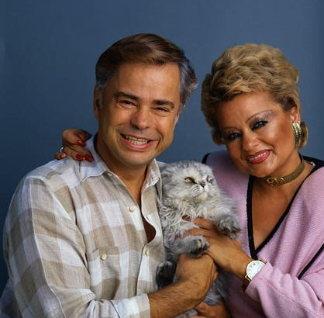
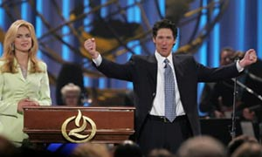
Church Splits
Pope in Avignon, France
Luxuries
Good life – too good
People angered over excesses of the church

Slide 12
Schism
People tired of this pope and elected a new one in Rome
For about 40 year two popes ruled
People pushed further
Bible in vernacular – John Wycliffe
Jan Huss pushed further – burned at the stake

Slide 13
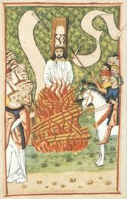
Jan Huss – Followers Hussites

Slide 14
Hundred Years’ War
Who is fighting?
England & France
Why?
Edward III (King of England) mother was a French princess
Claimed French Throne
Control of English Channel - trade
Pride

Slide 15
English dominates war
Better army,
weapons,
organization,
allies in France,
battles all on enemy soil

Slide 16
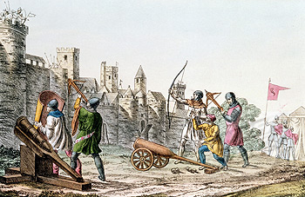
French counter the long bow

Slide 17
Joan of Arc
Angels advised her in the process of saving France
Charles VII or the Dauphin - no choice – Joan led army
Inspired the troops
Convinced all doubters by telling them what no one else knew
Ended Siege of Orleans
English capture Joan and try to disprove her hearing Angels
Burn her at the stake for wearing men’s clothing

Slide 18
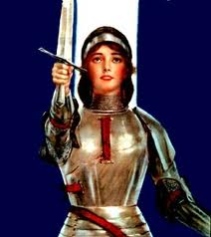
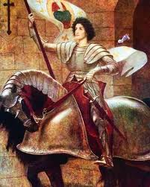
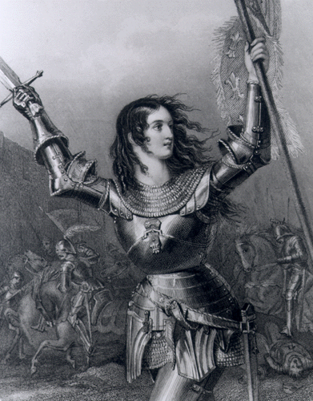
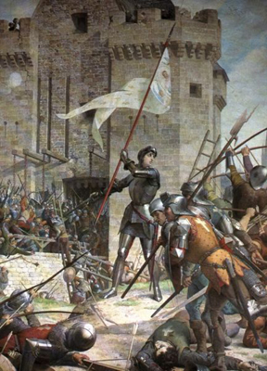
Joan

Slide 19
Results of Hundred Year’s War
National feeling in France
France monarchs expand power
English needs approval to raise taxes
Parliament’s power increases
“Power of the purse”
Turn to overseas lands
Long bow
Cannon
No more?
Trading increasesh

