Slide 1
Europeans in Southeast Asia
Hi flinty flint

Slide 2
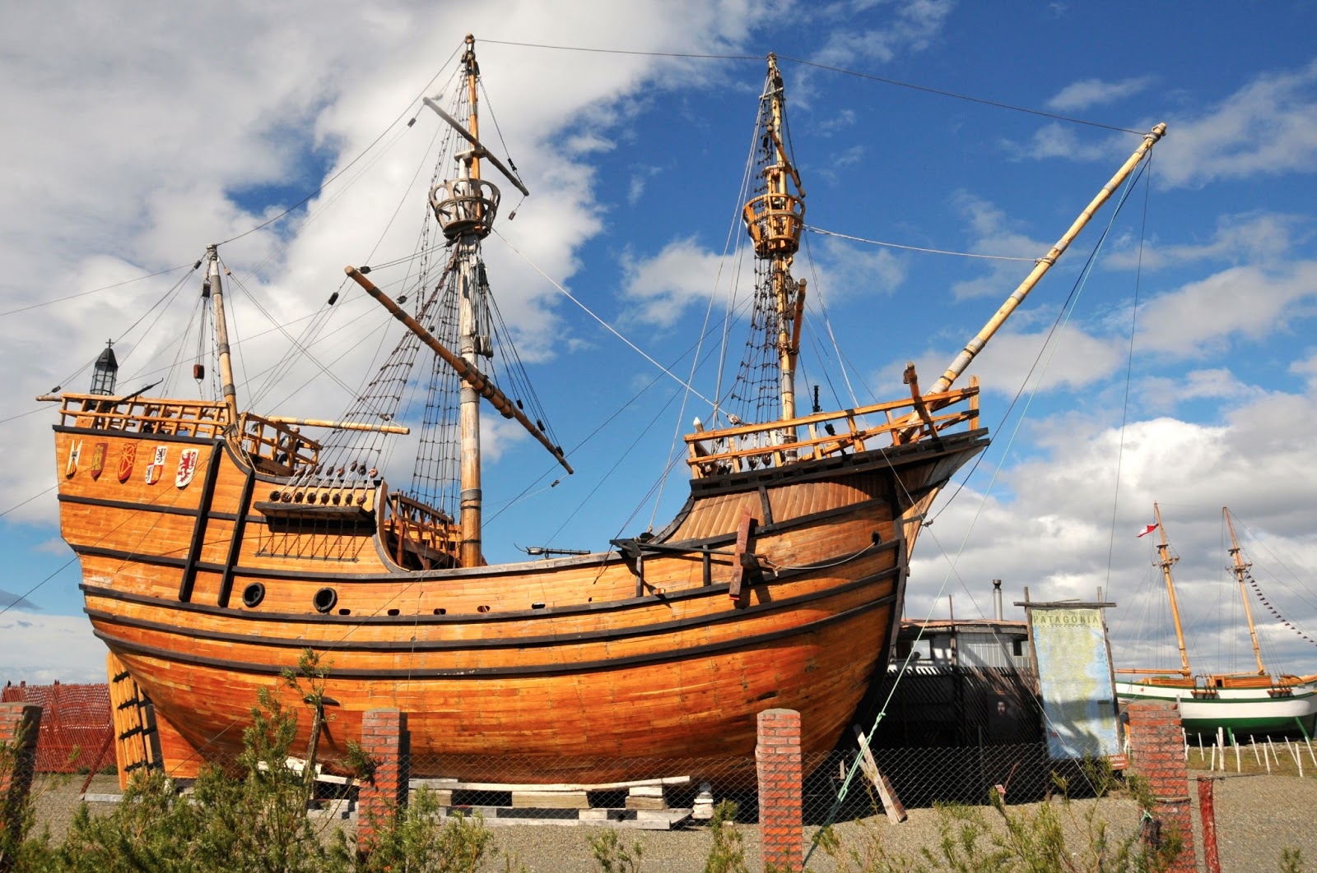
Why Portugal? – powerful cannons

Slide 3
How Portugal?
Mughal Empire – local princes in south had power
Europeans helped against Mughals

Slide 4
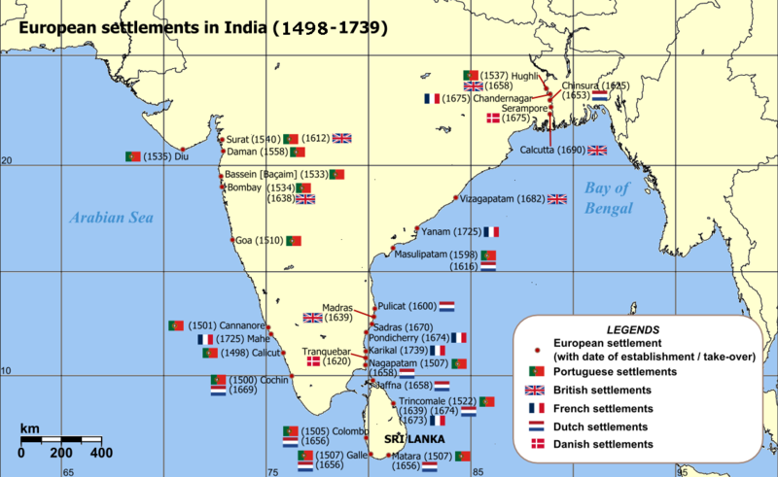
Portuguese Lake

Slide 5
Trading Empire
Built military and merchant outposts
Used cities to their advantage
Did not build their own
No colonies
Conversion – failure?
Violence (Muslims converted people through force, but stayed)
Destroyed temples (Muslim & Hindu)

Slide 6
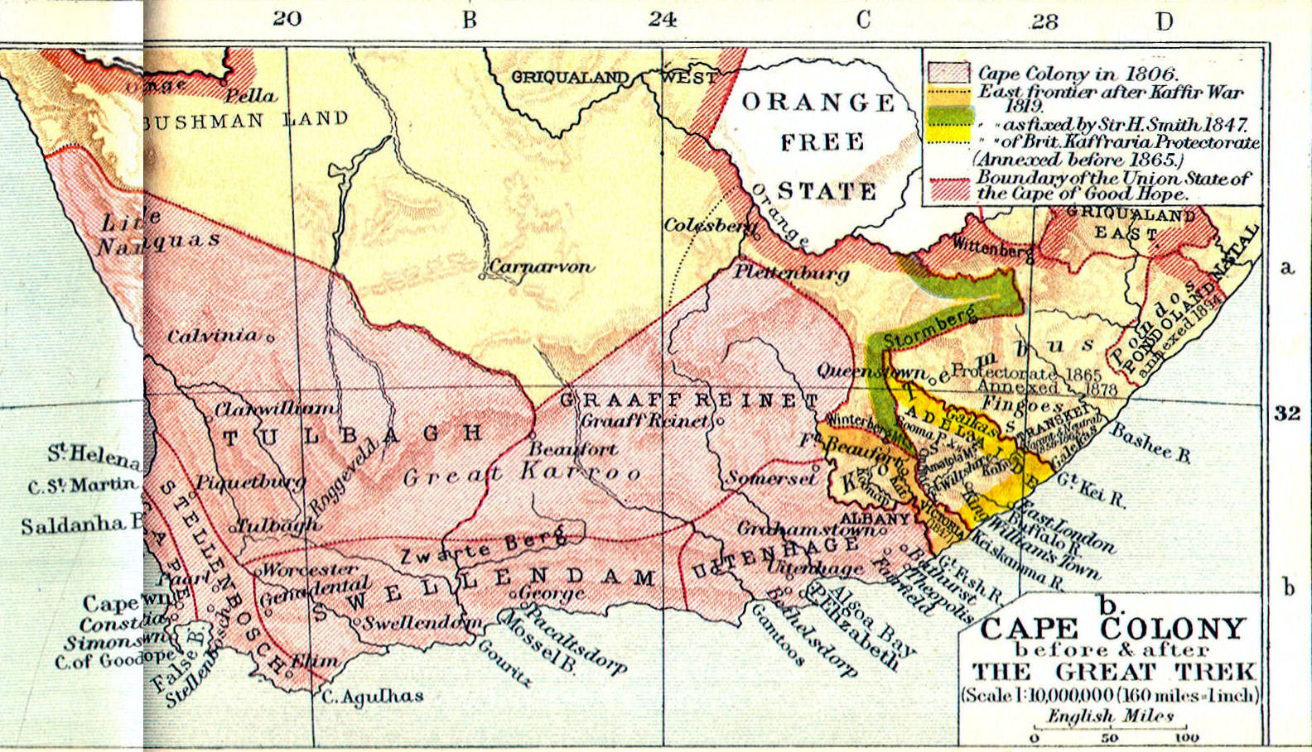
Dutch
Unlike Portuguese made settlements – Cape Town

Slide 7
Dutch East India Company
Sovereign Powers
Build armies
Wage war
Negotiate peace treaties
Govern overseas territory
Better connections
Military
Worked with local rulers
Merchants married Asian women

Slide 8
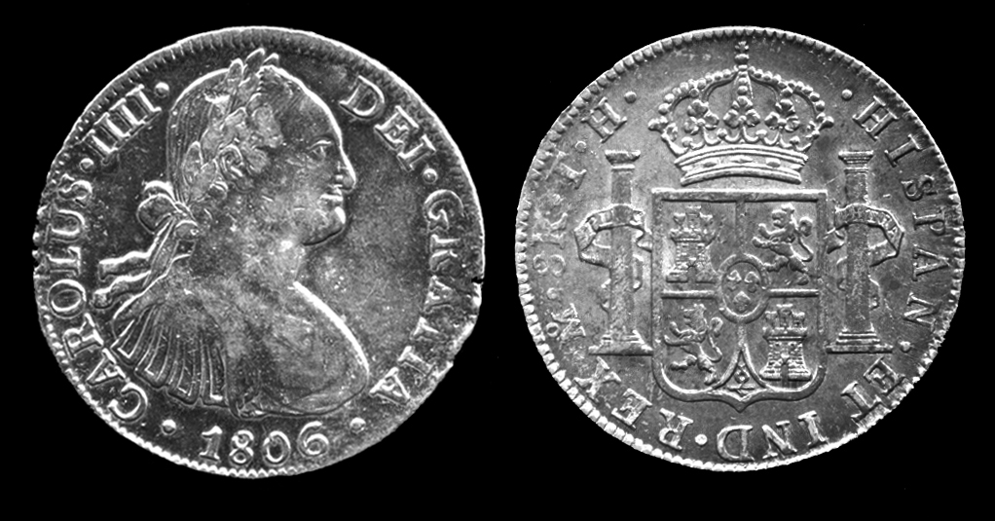
Spain takes the Phillippines
Filipinos did not work as one (not united)
Convert to Chrisitianity
Spanish silver Phillippines base buy goods in East Asia (satisfies China’s demands for only gold and silver

Slide 9
Mughal India
Spice trade, leader in textiles, silk and cotton cloth
No threat?
Allowed English and French forts

Slide 10
Why Europeans take over? British especially
Muslims and Hindu princes
Drained resources
Increased taxes – rebellions
Alliances with local rajahs
Countries had sepoys – Indian troops

