Slide 1
China - Isolationists
Still today – Why? History

Slide 2
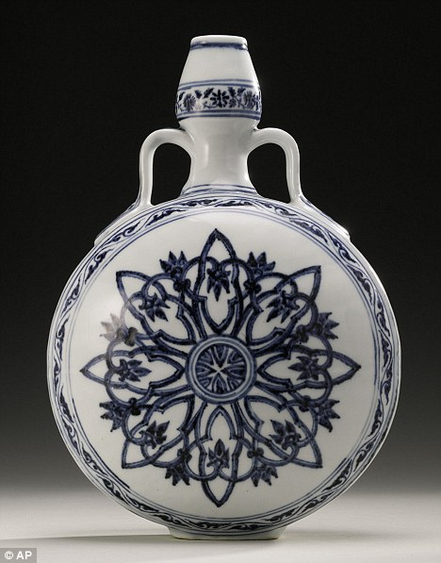
Ming China
Dynasties – how does this work?
Golden Age dynasty
Ming vase
Used as doorstop
$1.3 million

Slide 3
China
China at highpoint of civilization
Products inferior to west
Payment in gold or silver – Would you trade? Why?
Once done trading the Europeans had to leave. Why?
Lack of respect; products inferior so are people?

Slide 4
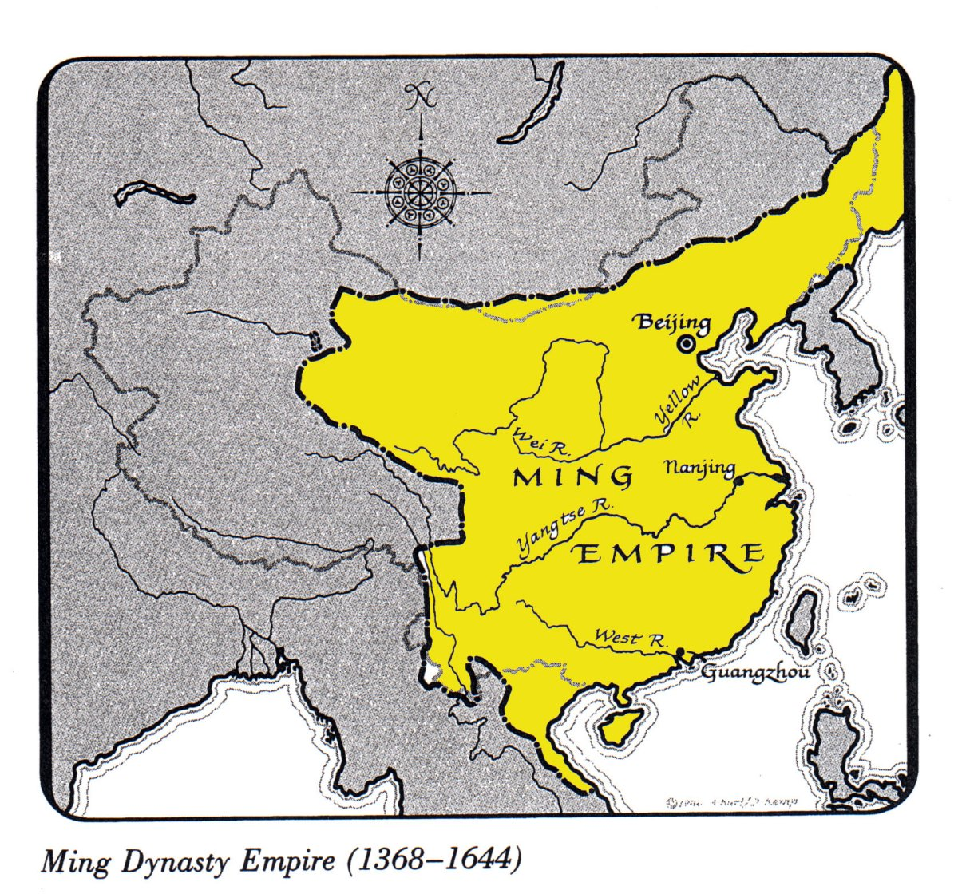

Slide 5
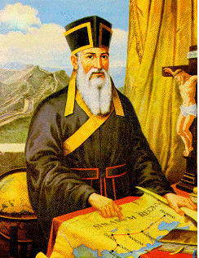
Portuguese Missionaries
Outside of trading main way to learn about culture
Jesuits respected them – intelligent, some fluent
Matteo Ricci – intelligent, Italian Jesuit who was fluent in Chinese

Slide 6
Manchu Conquest
Invaders from the north took over Ming and set up Qing Dynasty
Confucian system of government
Chinese ran government – Manchu occupying force

Slide 7
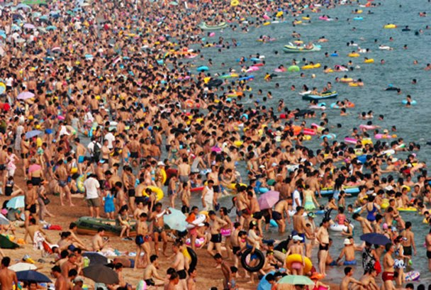
Chinese Population Expands
Potatoes and corn – output increases – population increase
140 to 300 million by 1800 (60 years)

Slide 8
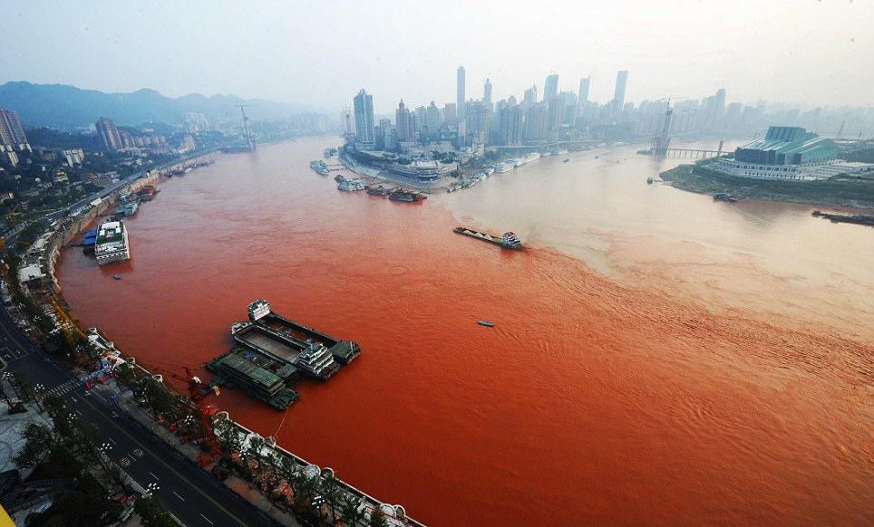
Chinese Pollution – Huangpu River

Slide 9
Poor Interaction
Language issues – Chinese viewed goods as gifts
Speak directly with emperor
Refused to kowtow
Lord Macartney told Chinese of natural superiorioty of Englsih

Slide 10
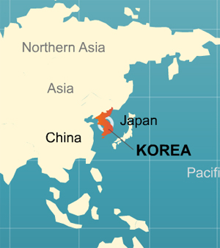
Korea
Geographically in bad location. Why?
Taken over by Japanes, Manchus

Slide 11
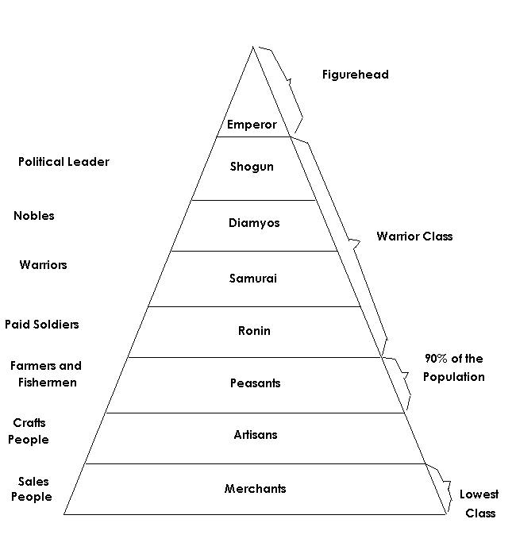

Slide 12
Why is Japan concerned with foreigners?
Spain had taken Philippines
Rather easily
Christian missionaries numbered close to 300,000s
Loyalty to Pope not Emperor
Outlawed large ships
Allowed two Dutch ships/year

